Slide 1
Access Control Lists
Introducing ACL Operation

Slide 2
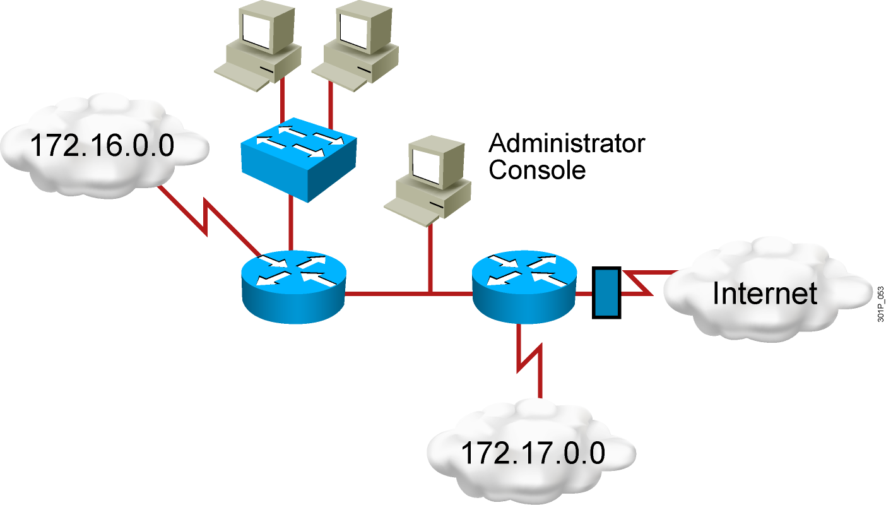
Why Use ACLs?
Filtering: Manage IP traffic by filtering packets passing through a router
Classification: Identify traffic for special handling
Notes:
Layer 2 of 2
Emphasize: An access list is a mechanism for identifying particular traffic. One application of an access list is for filtering traffic into or out of a router interface.

Slide 3
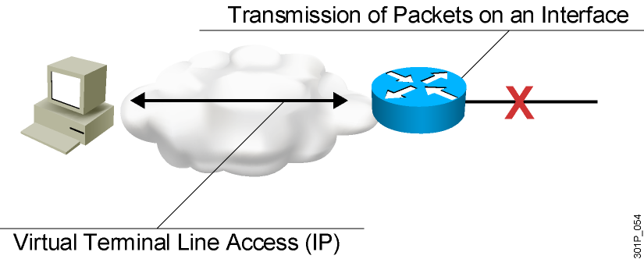
ACL Applications: Filtering
Permit or deny packets moving through the router.
Permit or deny vty access to or from the router.
Without ACLs, all packets could be transmitted to all parts of your network.
Notes:
Purpose: This figure illustrates common uses for IP access lists.
Emphasize: While this chapter focuses on IP access lists, the concept of access lists as mechanisms to control traffic in a network applies to all protocols.
Note: An improved security solution is the lock-and-key access feature, which is available only with IP extended access lists. Lock-and-key access allows you to set up dynamic access lists that grant access per user to a specific source/destination host through a user authentication process. You can allow user access through a firewall dynamically, without compromising security restrictions.
Transition: The following figure is the first of a three-layer build that presents other uses of access lists specific to Cisco IOS™ features.

Slide 4
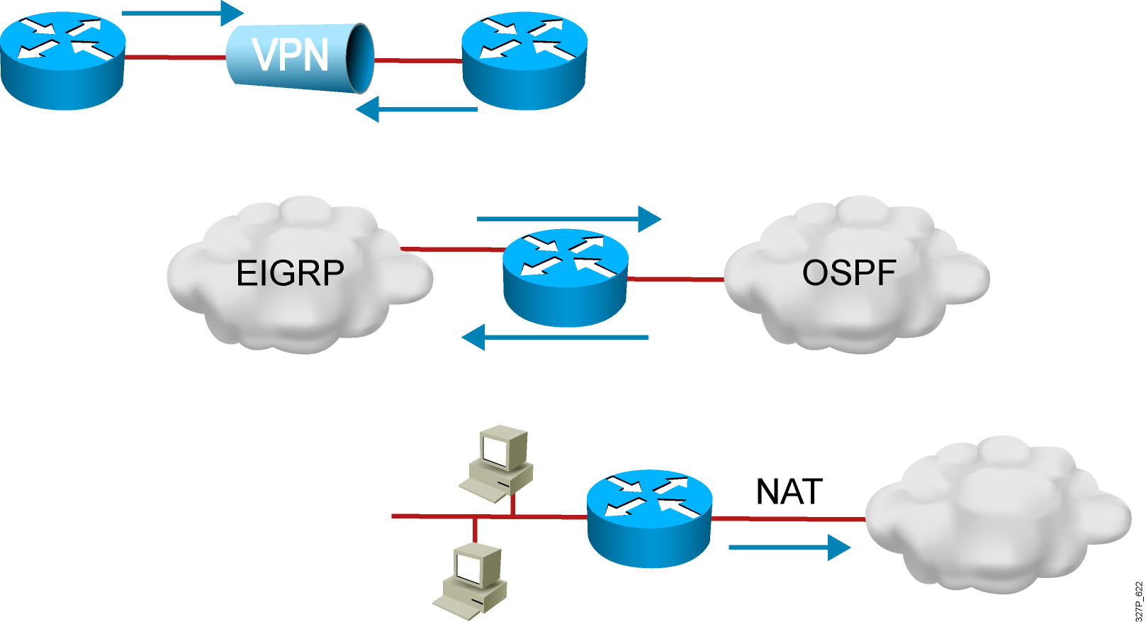
ACL Applications: Classification
Special handling for traffic based on packet tests
Notes:
Layer 3 of 3
Purpose: This figure is the last layer of the build for other uses of access lists.
Emphasize: Access lists are used to define input traffic for route filtering to restrict the contents of routing updates.
Transition: The following figure is a two-layer build to show the difference between inbound and outbound access lists.

Slide 5
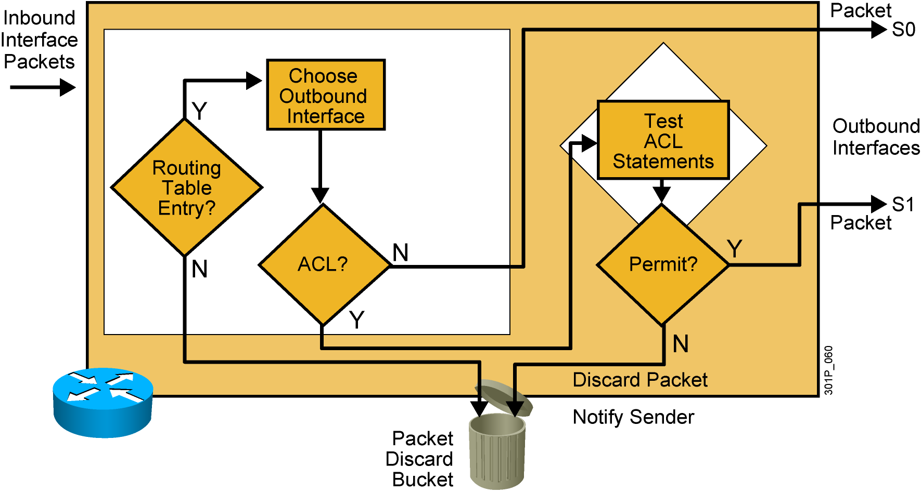
Outbound ACL Operation
  If no ACL statement matches, discard the packet.
Notes:
Layer 3 of 3
Purpose: Shows a deny result of the access list test.
Emphasize: Now the packet is discarded into the packet discard bucket. The unwanted packet has been denied access to the outbound interface.
The Notify Sender message shows a process like ICMP, returning an “administratively prohibited” message back to the sender.

Slide 6
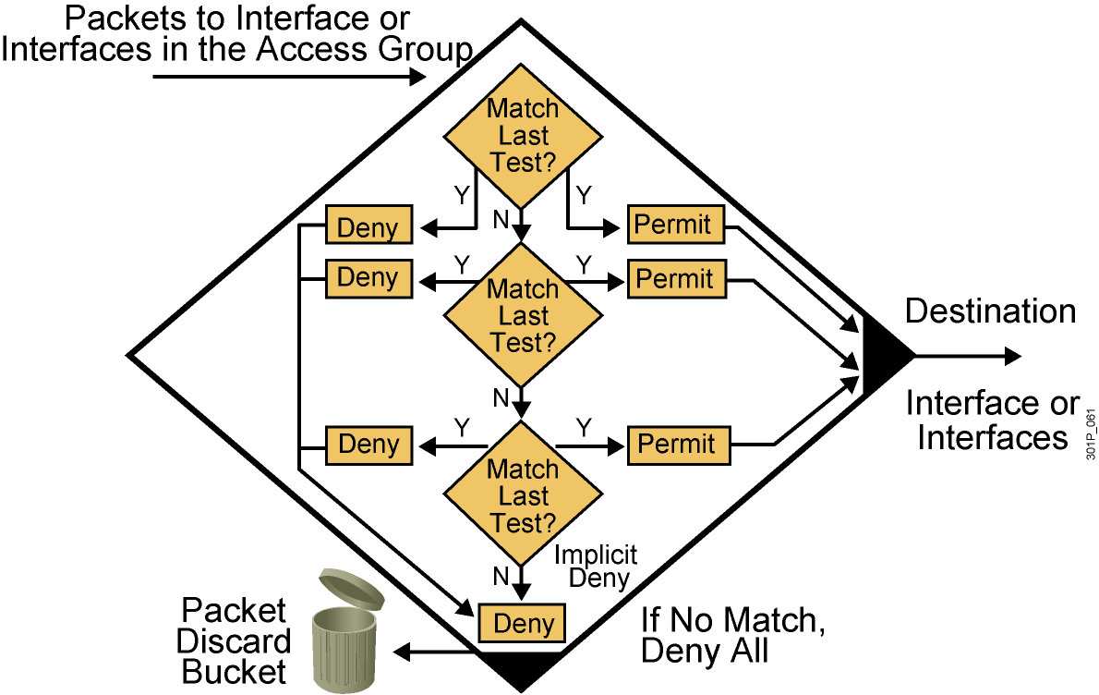
A List of Tests: Deny or Permit
Notes:
Layer 4 of 4
Purpose: Shows the implicit “deny all.”
Emphasize: Describe the final access list test to match any packets not covered by earlier access list statements. All remaining packets match the “Implicit Deny” and are discarded into the bit bucket.

Slide 7
Types of ACLs
Standard ACL
    Checks source address
    Generally permits or denies entire protocol suite
Extended ACL
    Checks source and destination address
    Generally permits or denies specific protocols and applications
Two methods used to identify standard and
extended ACLs:
    Numbered ACLs use a number for identification
    Named ACLs use a descriptive name or number for identification
Notes:
Layer 3 of 3
Purpose: Describe an inbound versus outbound access list on an interface.

Slide 8
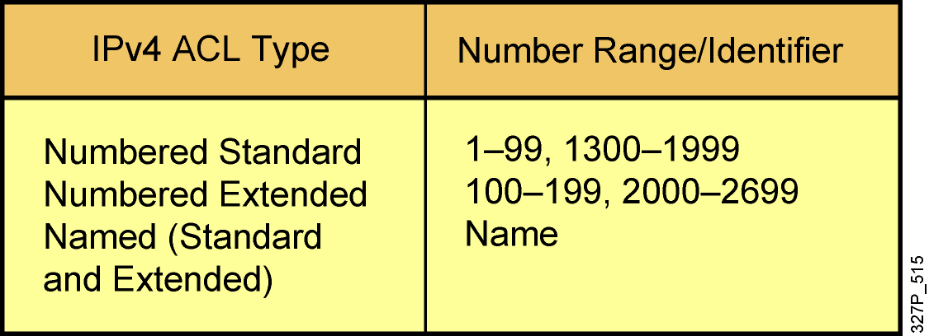
How to Identify ACLs
Numbered standard IPv4 lists (1–99) test conditions of all IP
packets for source addresses. Expanded range (1300–1999).
Numbered extended IPv4 lists (100–199) test conditions of source
and destination addresses, specific TCP/IP protocols, and destination
ports. Expanded range (2000–2699).
Named ACLs identify IP standard and extended ACLs with an
alphanumeric string (name).
Notes:
Layer 3 of 3
Emphasize: Layer 3—Adds the Novell IPX access lists covered in Chapter 11, “Configuring Novell IPX,” and the number ranges for these types of access lists. As of Release 11.2.4(F), IPX also supports named access lists.
Point out that number ranges generally allow 100 different access lists per type of protocol. When a given hundred-number range designates a standard access list, the rule is that the next hundred-number range is for extended access lists for that protocol.
Exceptions to the numbering classification scheme include AppleTalk and DECnet, where the same number range can identify various access list types.
For the most part, number ranges do not overlap between different protocols.
Note: With Cisco IOS 12.0, the IP access-lists range has been expanded to also include:
<1300-1999> IP standard access list (expanded range)
<2000-2699> IP extended access list (expanded range)

Slide 9
IP Access List Entry Sequence Numbering
  Requires Cisco IOS Release 12.3
  Allows you to edit the order of ACL statements using sequence numbers
    In software earlier than Cisco IOS Release 12.3, a text editor is used to create ACL statements, then the statements are copied into the router in the correct order.
  Allows you to remove a single ACL statement from the list using a sequence number
    With named ACLs in software earlier than Cisco IOS Release 12.3, you must use no {deny | permit} protocol source source-wildcard destination destination-wildcard to remove an individual statement.
    With numbered ACLs in software earlier than Cisco IOS Release 12.3, you must remove the entire ACL to remove a single ACL statement.

Slide 10
ACL Configuration Guidelines
  Standard or extended indicates what can be filtered.
  Only one ACL per interface, per protocol, and per direction is allowed.
  The order of ACL statements controls testing, therefore, the most specific statements go at the top of the list.
  The last ACL test is always an implicit deny everything else statement, so every list needs at least one permit statement.
  ACLs are created globally and then applied to interfaces for inbound or outbound traffic.
  An ACL can filter traffic going through the router, or traffic to and from the router, depending on how it is applied.
  When placing ACLs in the network:
    Place extended ACLs close to the source
    Place standard ACLs close to the destination

Slide 11
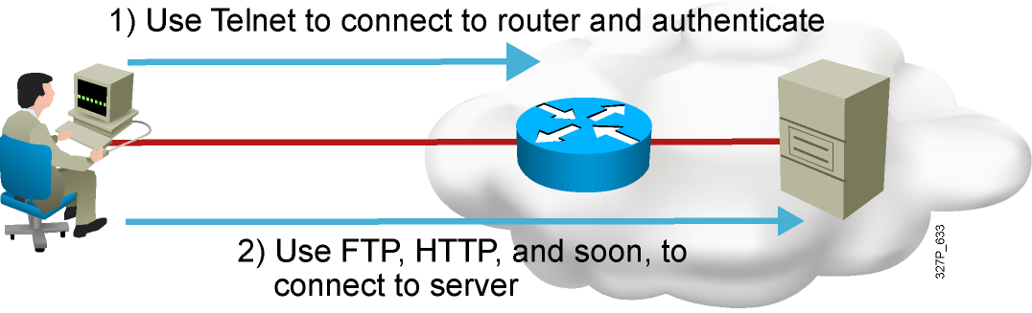
Dynamic ACLs
Dynamic ACLs (lock-and-key): Users that want to traverse the router
are blocked until they use Telnet to connect to the router and are
authenticated.

Slide 12
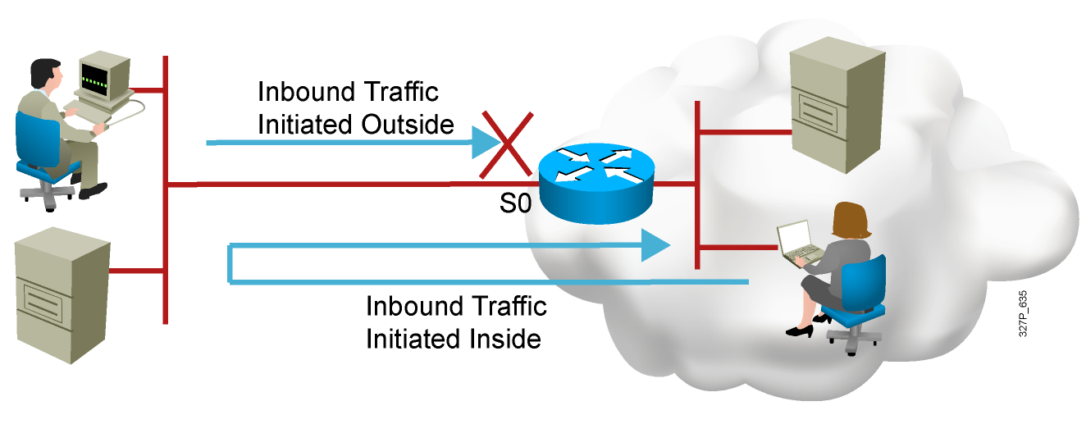
Reflexive ACLs
Reflexive ACLs: Used to allow outbound traffic and limit inbound
traffic in response to sessions that originate inside the router

Slide 13
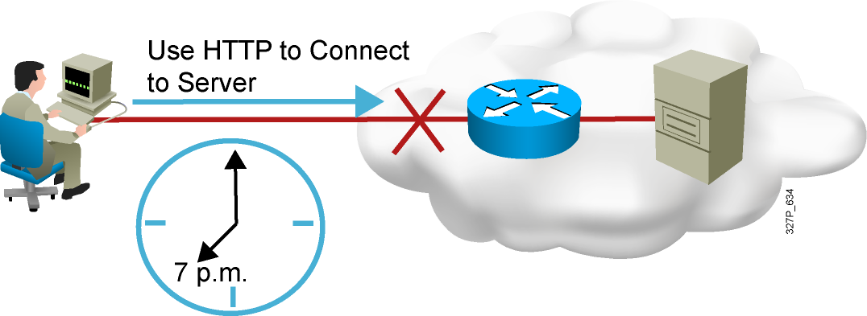
Time-Based ACLs
Time-based ACLs: Allow for access control
based on the time of day and week

Slide 14
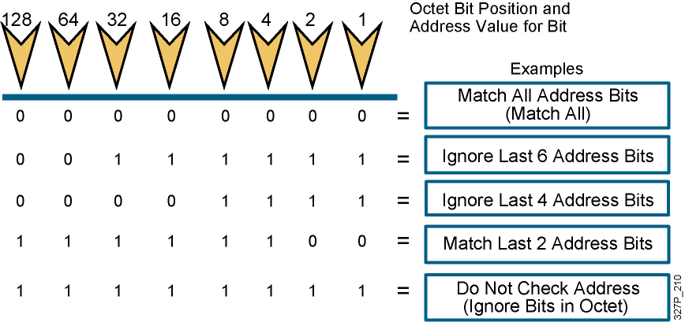
Wildcard Bits: How to Check the Corresponding Address Bits
  0 means to match the value of the corresponding address bit
  1 means to ignore the value of the corresponding address bit
Notes:
Purpose: This graphic describes the binary wildcard masking process.
Emphasize: Introduce the wildcard bit process. Tell students that the wildcard bit matching process is different than the IP subnet addressing mask covered earlier.
Illustrate how wildcard masking works using the examples shown in the graphic table.
The term wildcard masking is a nickname for this access list mask-bit-matching process. This nickname comes from an analogy of a wildcard that matches any other card in a poker game.
Emphasize the contrast between wildcard masks and subnet masks, stated in the Student Guide note. The confusion over wildcard and subnet masks can be a key obstacle to learning if students fail to understand the different uses of binary 0 and binary 1 in the two mask types.
Point out that the 1 bits in a wildcard mask need not be contiguous, while the 1 bits in a subnet mask need to be contiguous.
Wildcard is like the DOS “*” character.

Slide 15
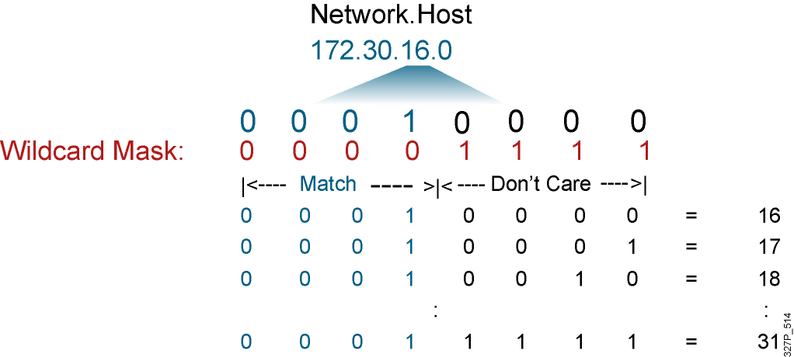
Wildcard Bits to Match IP Subnets
Match for IP subnets 172.30.16.0/24 to 172.30.31.0/24.
Address and wildcard mask:
172.30.16.0 0.0.15.255
Notes:
Purpose: This slide describes an example of how wildcard mask bits will match all hosts on subnets 172.30.16.0/24 to 172.30.31.0/24.
Emphasize: This process requires a thorough understanding of binary numbering, what values to use in the power of two bit positions, and how to convert a number from decimal to binary.
If some of your students seem to lack this understanding, tell them that responsibility for complex access list design is an advanced configuration skill. Later, this course offers a hands-on lab to allow practice designing simple access lists.
If you feel that your students need another example to improve their understanding of the process, prepare another example as a chalk talk. Consider having students volunteer to help as you solve your own example that lines up the binary bits of the address and the binary bits of the wildcard mask.

Slide 16
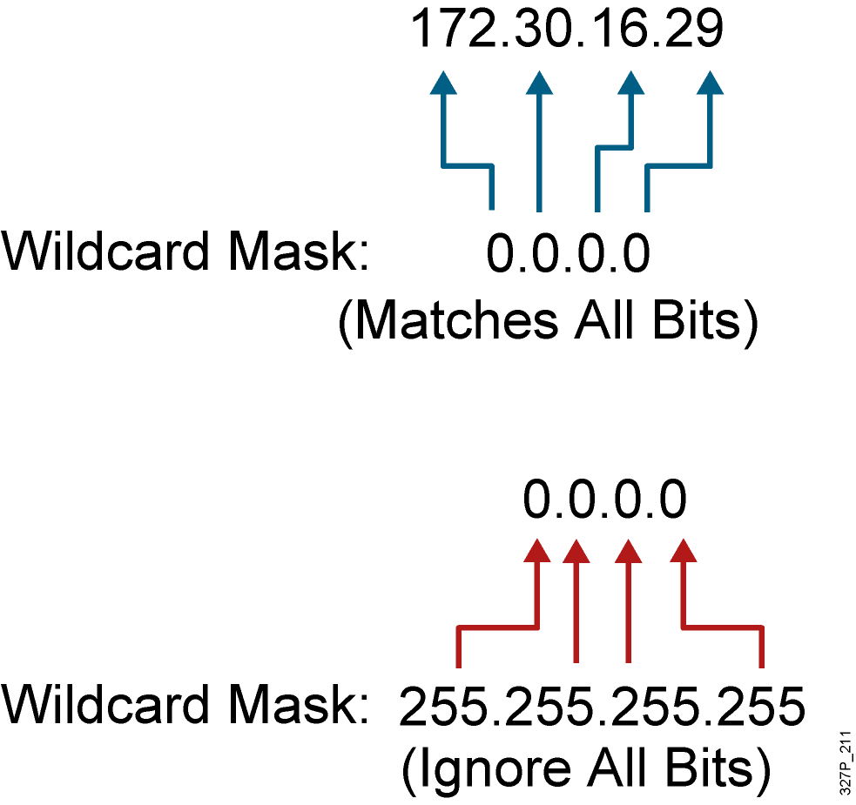
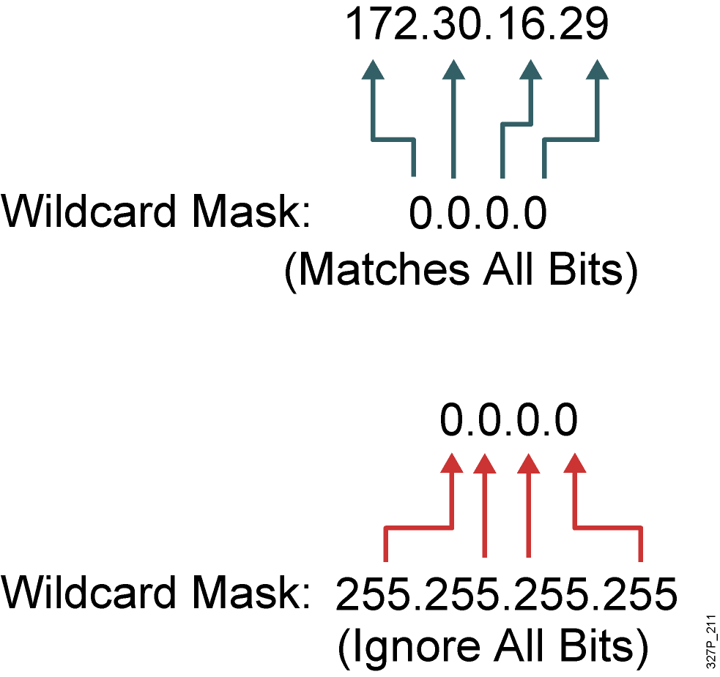
Wildcard Bit Mask Abbreviations
172.30.16.29 0.0.0.0 matches
all of the address bits
Abbreviate this wildcard mask
using the IP address preceded
by the keyword host
(host 172.30.16.29)
0.0.0.0 255.255.255.255
ignores all address bits
Abbreviate expression
with the keyword any
Notes:
Purpose: This graphic shows students how to use the host abbreviation in the extended access list wildcard mask.
Emphasize: This abbreviation means check the bit value in all bit positions, which has the effect of matching only the specified IP host address in all bit positions.

Slide 17
Summary
  ACLs can be used for IP packet filtering or to identify traffic to assign it special handling.
  ACLs perform top-down processing and can be configured for incoming or outgoing traffic.
  You can create an ACL using a named or numbered ACL. Named or numbered ACLs can be configured as standard or extended ACLs, which determines what they can filter.
  Reflexive, dynamic, and time-based ACLs add more functionality to standard and extended ACLs.
  In a wildcard bit mask, a 0 bit means to match the corresponding address bit and a 1 bit means to ignore the corresponding address bit.

